Slide 1







IBM Data Analysis Capstone
Chris Valentin
October 17, 2024

Slide 2



OUTLINE
Executive Summary
Introduction
Methodology
Results
Visualization – Charts
Dashboard
Discussion
Findings & Implications
Conclusion
Appendix

Slide 3

EXECUTIVE SUMMARY
Demographics plays an important role in technologies.
There is always room for growth in what you currently work on vs what you desire to learn.
Even though most individuals know a programming language they still want to learn more.
Most individuals that work on Databases they still want to learn about more databases.
The survey consists of a lot of data and it is very comprehensive.

Slide 4

INTRODUCTION
Introduce Programming Language Trends
Introduce Database Trends
Review and evaluate Dashboards
Overall Findings and Implications
Job Postings via location
Salary per Programming Language

Slide 5

METHODOLOGY
Gathered and Wrangle the data.
Evaluate the Excel for Data Analysis
Implemented Exploratory Data Analysis
Visualize the Data

Slide 6
RESULTS

Slide 7
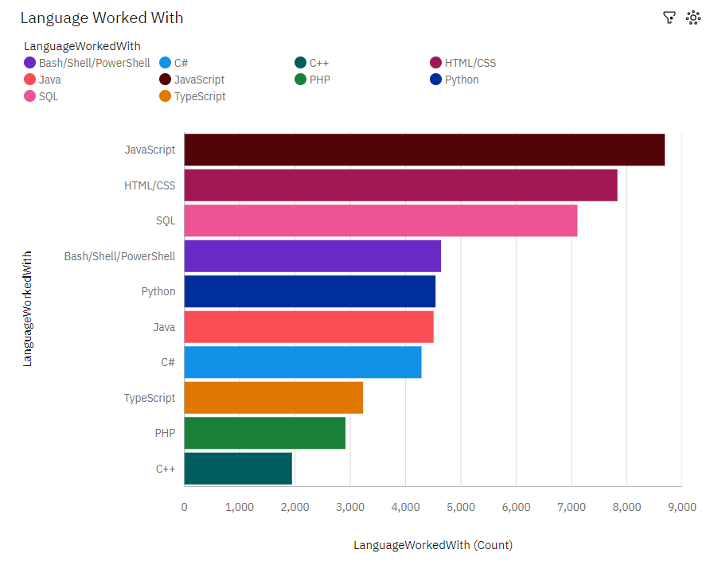
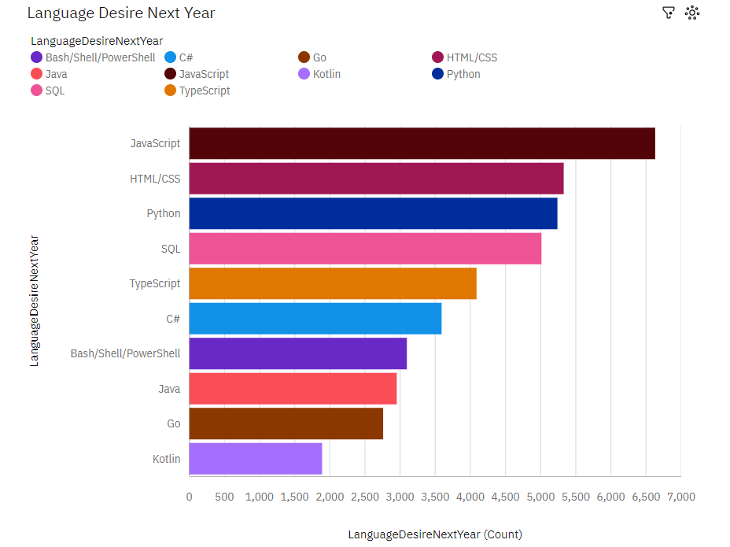
PROGRAMMING LANGUAGE TRENDS
Current Year
Next Year

Slide 8
PROGRAMMING LANGUAGE TRENDS - FINDINGS & IMPLICATIONS
Findings
8 out of 10 languages are currently what people work on and what they plan to learn next year.
Go and Kotlin are two new languages individual want to learn the next year.
JavaScript and HTML are both the top 2 worked on languages and the team wants to learn next year.
Implications
PHP and C+ fell out of the top 10 for learning next year.
Training for Top 10 languages was less than top 10 worked on for current year.

Slide 9
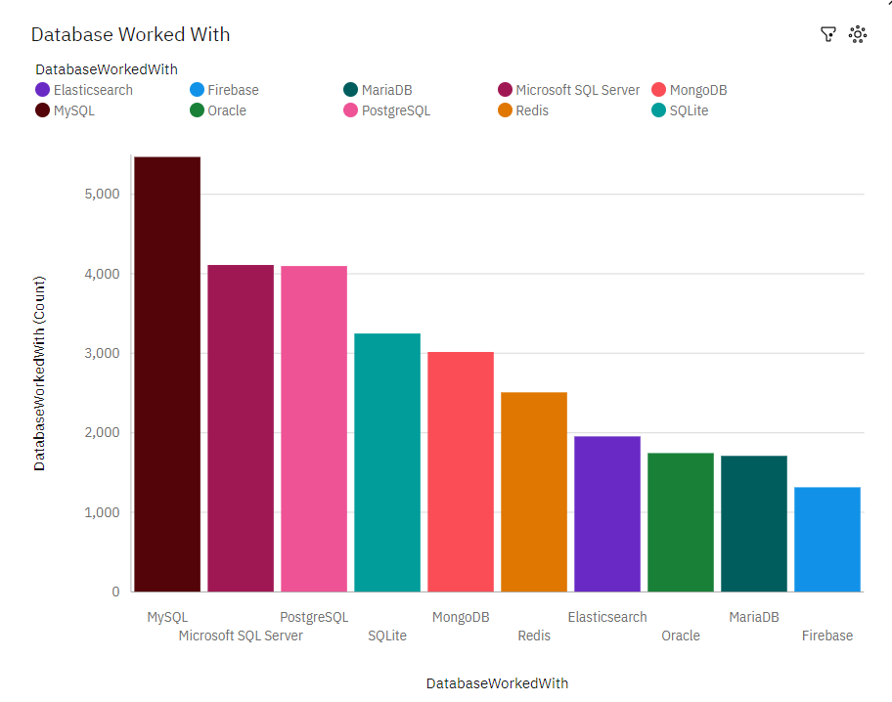
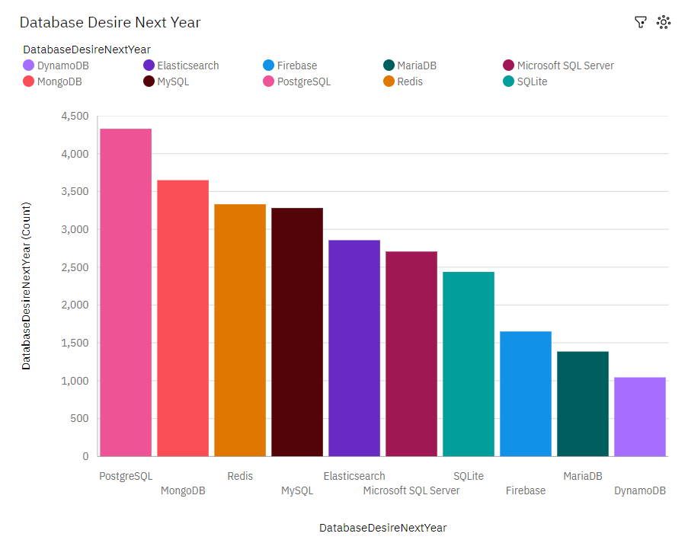
DATABASE TRENDS
Current Year
Next Year

Slide 10
DATABASE TRENDS - FINDINGS & IMPLICATIONS
Findings
Dynamo DB is new on the list for individuals to learn next year.
Individuals work on 9 out of 10 languages and they will also be on the top 10 desirable for next year.
Implications
Oracle is not a DB someone would like to learn next year.
Most languages swapped places from what individua's worked on compared to what they would like to learn.

Slide 11

DASHBOARD
https://github.com/Elcarnicero/IBMDataAnalysisCapstone

Slide 12
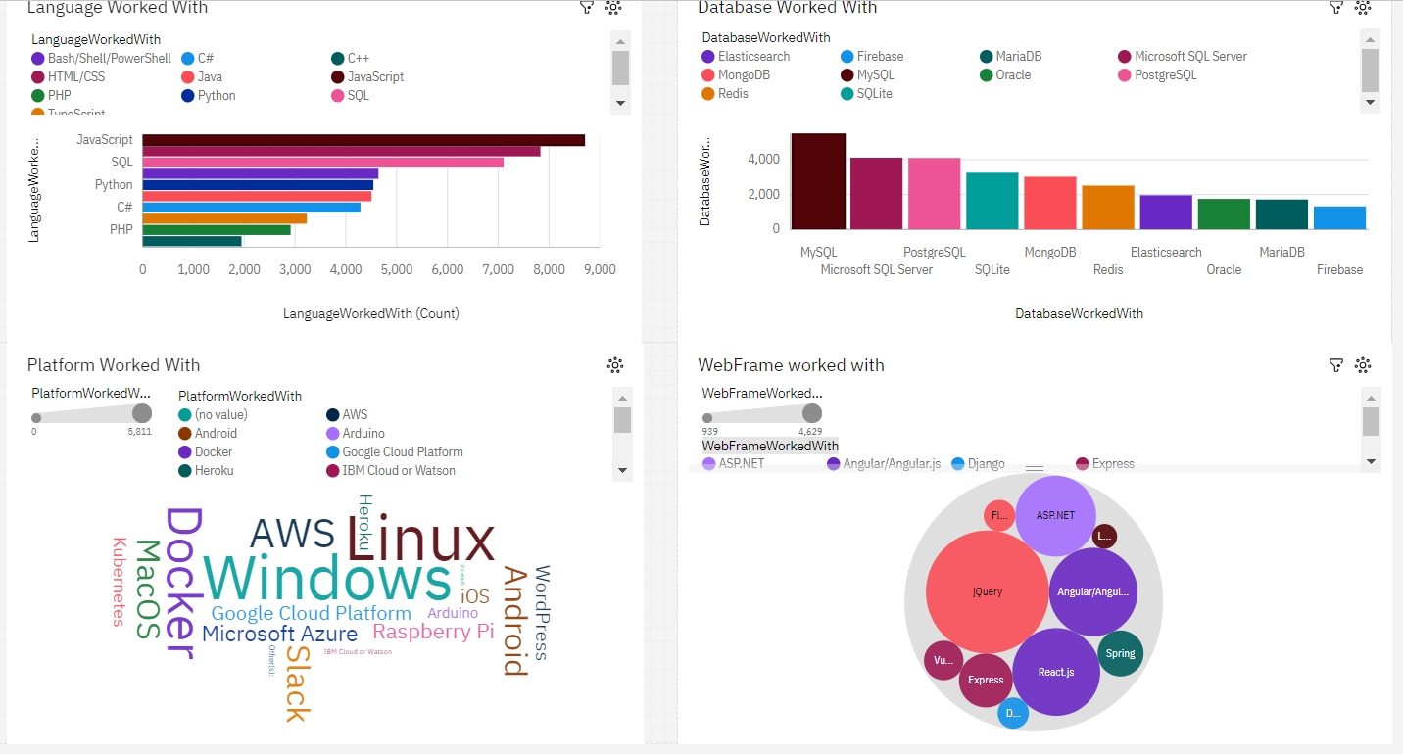
DASHBOARD TAB 1 - Current Tech
Screenshot of dashboard tab 1 goes here

Slide 13
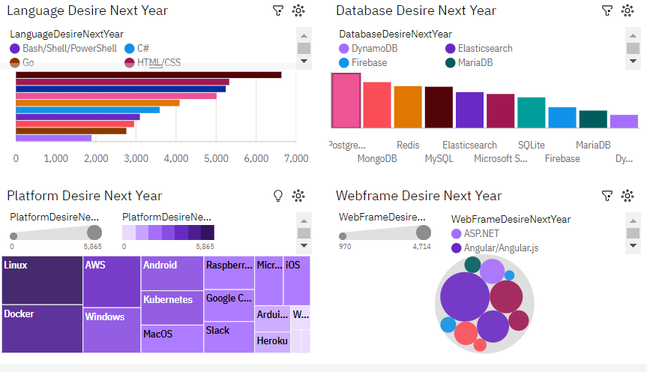
DASHBOARD TAB 2 – Future Tech
Screenshot of dashboard tab 2 goes here

Slide 14
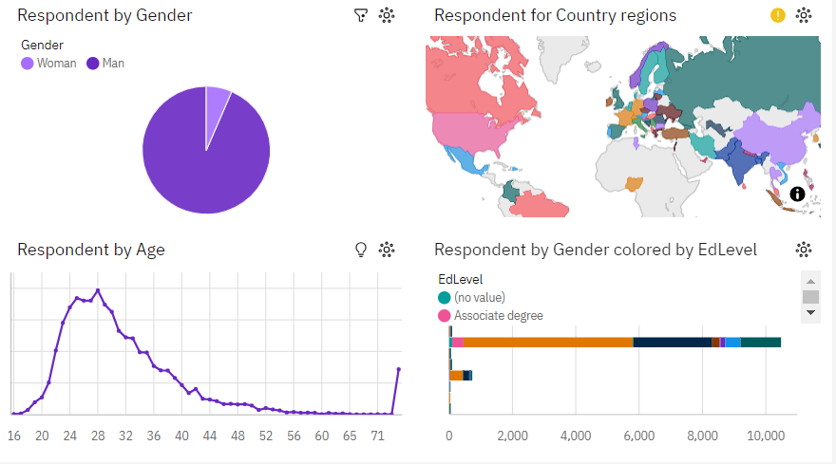
DASHBOARD TAB 3 - Demographics
Screenshot of dashboard tab 3 goes here

Slide 15
DISCUSSION

Slide 16
OVERALL FINDINGS & IMPLICATIONS
Findings
Personnel with a Bachelor’s Degree make more money than all other educated levels.
Personnel with a Master Degree earned the second most money.
Most Bachelor Degree recipients earned the most between Age 23 and 35.
Implications
Primary / elementary school earned the least amount.
Personnel with Bachelor’s degrees worked more hours than most.
Implication 3

Slide 17

CONCLUSION
Education plays a big role in salary and career.
65% of respondents have a Computer Science Degrees
64% of respondents enjoy have a Better life; even though, most respondents are in office.
There is an individual that is 99 years old still working.

Slide 18

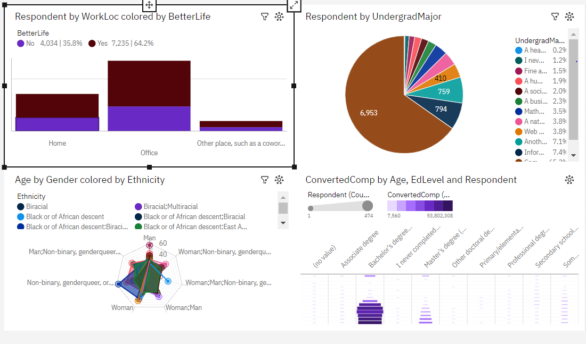
APPENDIX

Slide 19
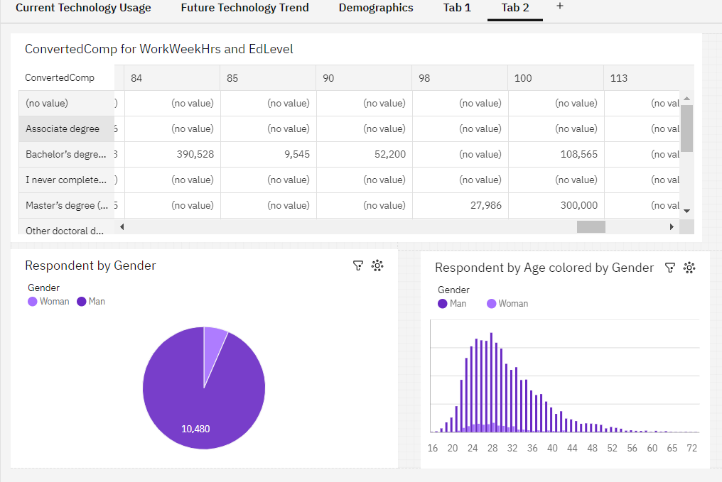
APPENDIX

Slide 20
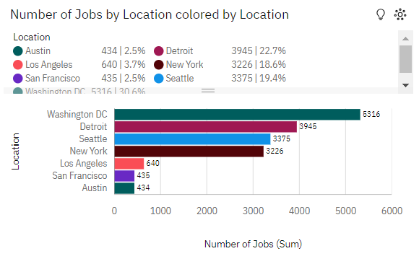
JOB POSTINGS
In Module 1 you have collected the job posting data using Job API in a file named “job-postings.xlsx”. Present that data using a bar chart here. Order the bar chart in the descending order of the number of job postings.

Slide 21
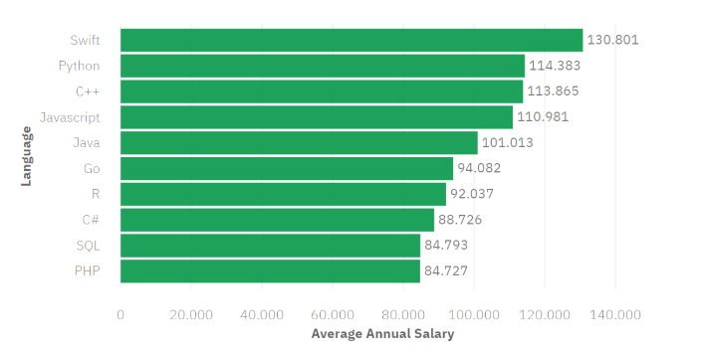
POPULAR LANGUAGES
In Module 1 you have collected the job postings data using web scraping in a file named “popular-languages.csv”. Present that data using a bar chart here. Order the bar chart in the descending order of salary.

